Slide 1
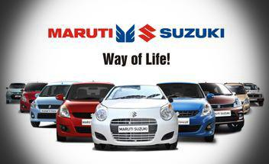
Comprehensive Digital marketing for

Slide 2
Team Details Maddili Swapna (Team Lead) Naviri Suguna (Team Member) Nayana Harika(Team Member) Revalla Sharmila(Team Member) Sailada Bhagyasri(Team Member)

Slide 3
PART- 1 Brand study Competitor Analysis Audience/Buyers Persona

Slide 4
Brand Study:
Research brand:
Maruti Suzuki is a well-known brand in the automotive industry.
Maruti Suzuki, formerly known as Maruti Udyog Limited, was established in 1981 as a joint venture between the Indian government and Suzuki Motor Corporation of Japan.
It has played a significant role in the growth and development of the Indian automotive industry.
For many consecutive years, Maruti Suzuki India Limited has been the largest passenger car manufacturer and seller in India. Recently, it has sold 1,729,826 passenger cars, which is around 51% market share of of the Indianpassenger car market in 2019, while its nearest competitor Hyundai India could sold 545,243 passenger cars, whichis 16% of the market share.
Mission:
Maruti Suzuki’s mission is centered around delivering value and innovation to its customers and contributing to society.
To be the leader in the Indian Automobile Industries by providing Customer satisfaction, innovation and quality , responsible business practices to its customers.

Slide 5
Values:
The brand act with professionalism and conduct brand with the highest sense of professionalism,ethics and promote integrity and competency in Target audience.
They are Client centric, provide quality and excellence in their brands,they value about trust, credibility and commitment.
Unique Selling Proposition(USP):
Maruti Suzuki has car models in every segment with a wide price range to choose from,apart from being the most reliable name in automobile industry.
It’s affordability and reliability makes the brand very unique.
Brand Identity:
Logo: The logo features the brand’s name in a bold, uppercase font with a prominent letter ‘S’ and a silver, stylized ‘M’ within a circular emblem. The color scheme is typically blue and silver, representing trust, reliability, and innovation.

Slide 6
Tagline :Maruti Suzuki has used various slogans/taglines over the years, but “Way of Life!” has been one of its enduring taglines, reflecting its impact on people’s lives and the Indian automotive market.
Brand Tone:Maruti Suzuki’s tone of voice should generally reflect the brand’s values and image, which include qualities like reliability, affordability, and a strong presence in the Indian automotive market.
Vision:”To make every journey an experience and every experience a memory”, Maruti Suzuki puts people at the centre of everything it does.
SMART Goals:
Specific:Increase the sales by 30% over last year sales during the same time period by increasing advertising budget.
Measurable:Maruti Suzuki needs to focus on metrics that are consistent with the values and interests of the wider stakeholders.

Slide 7
Achievable:
By improving service and reducing resolution time.
Relevant:
Under the realistic analysis, managers at Maruti Suzuki should focus on the scope and timeline of the project
If the goals are unrealistic then employees at Maruti Suzuki will become demotivated to achieve the goals.
Time Bound:
Increase market share by 10% within next year .
KPIs:
Delivery performances
Quality of service
Customer reviews
Return on average equity
Return on Investment (ROA)

Slide 8
USP: The USP of Honda is the combination of reliability, fuel efficiency, and advanced technology.
Competitor analysis :-
Competitors of Maruti Suzuki:
1.HONDA:
Strengths | Weaknesses | Opportunities | Threats
The company has more than 1 million sales in the USA every year Honda has over 200,000 employees globally The brand has excellent marketing and advertising campaigns across the world. | Honda had to recall a few of their models for corrective measures which caused a lot of hue and cry. Intense competition in the automobile segment means limited market share growth. | Fast growing automobile market can be used by Honda to increase their business. Developing hybrid Honda cars and fuel efficient cars for the future. | Honda’s business can be affected by intense competition from global automobile brands. Ever increasing fuel prices can disrupt sales of cars.

Slide 9
2.Hyundai:
Strengths | Weaknesses | Opportunities | Threats
Hyundai vehicles are sold in more than 190 countries through some 5,000 dealerships and showrooms worldwide.It has over 75,000 employees globally. The company has excellent branding and advertising by having celebrity brand ambassadors. | Hyundai faces tremendous competition means limited market share growth. Controversies regarding fuel engines & incorrect advertising have hurt the brand in the past. | Developing cost-friendly Hyundai hybrid cars and fuel efficient cars for the future. Innovation into hybrid cars as well as electric variants can help the brand. | Intense competition from global automobile brands can reduce market share of Hyundai. Government policies for the automobile sector across the world.
USP: Hyundai Motor was the first to mass-produce a hydrogen-powered car.

Slide 10
3.Tata Motors:
Strengths | Weaknesses | Opportunities | Threats
Tata Motors has a wide & extensive distribution and service network Many associations like Jaguar Land Rover, Hispanso, Macropolo etc increases Tata Motors’ international presence. More than 70,000 employees are present with Tata Motors. | Limited international presence as compared to international car manufacturers Controversies like Singur plant for Nano etc hurt Tata Motors. | Expanding automobile market can be a boon for Tata Motors. Increasing per capita income and purchasing capability of potential customer base. | Competition from other big automobile giants means reduced market share for Tata Motors. Competitive products offering same level features at a lesser price.
USP: Tata Motors is positioned as a leader in automobile market inculcating innovative technologies to deliver value to customers.

Slide 11
SWOT analysis of Maruti Suzuki:
Strengths | Weaknesses | Opportunities | Threats
Maruti Suzuki is the largest passenger car company in India, accounting for around 45% market share. Over 12,000 people are employed with Maruti. Strong brand value and strong presence in the second hand car market. | Inability to penetrate into the international market Employee management, strikes, worker wage problems have affected Maruti’s brand image in the past. | Developing hybrid cars and fuel efficient cars for the future can be an opportunity for Maruti Suzuki Fast growing automobile market and increased purchasing power | Intense competition from global automobile brands and cheaper brands can hurt Maruti Suzuki’s business Government policies for the automobile sector across the world

Slide 12
Buyers/Audience’s persona:
Target audience :
Every person who searched for anything related to cars, car services, and vehicles.
People searching for cars are in majority among the age group of 25 to 50.
Majorly middle class families consider buying maruti suzuki cars because of it’s affordability and reliability.
Business professionals looking for low-maintenance vehicles, and innovative and trending world-class cars with advanced safety features.
Audience generally prefers cars which mostly satisfies with price, mileage,design and safety.
They will buy cars from company which provides them proper customer care service,sales service , insurance policies etc.

Slide 13
Demographic factors:
Age:People between 25-40 years are highly interested in buying cars from maruti suzuki
Gender:
Male-74%
Female-26%
occupation: corporate employees, government employees and mostly middle class people are interested in buying cars from maruti suzuki
Psychographic factors:
Values: Customers want the company to follow ethics
Interests: audience buy cars from maruti suzuki if the company provides customer satisfaction, affordability,realiability,less fuel consuming and give high mileage.

Slide 14
Part-2 Search Engine optimization (SEO) & Keyword Research

Slide 15
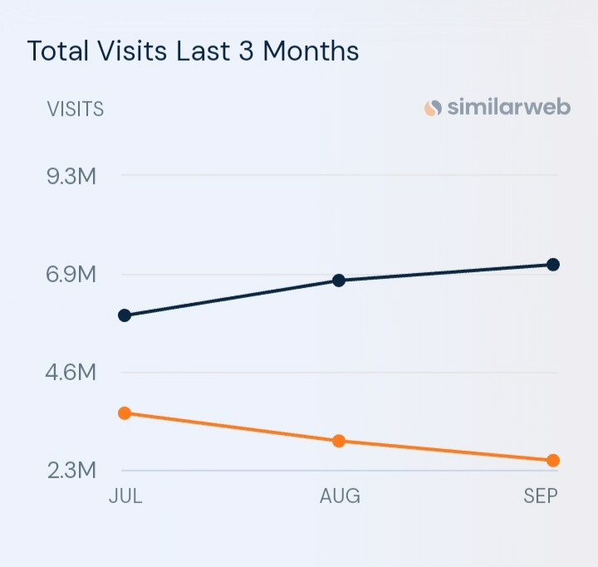
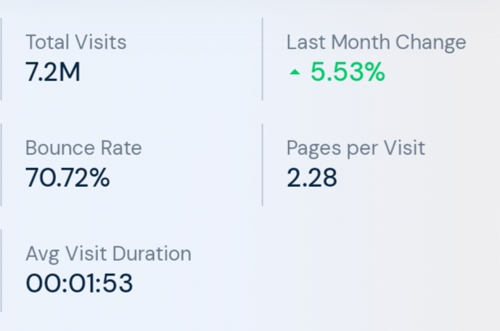
SEO Audit:
Website:marutisuzuki.com
Website Ranking:Over the last three months, marutisuzuki.com’s global ranking has decreased from 11,151 to 10,484.
Website traffic:marutisuzuki.com’s traffic has increased by 5.53% compared to last month
Engagement analysis:

Slide 16
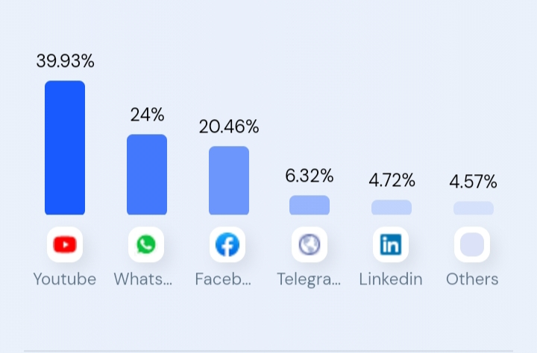
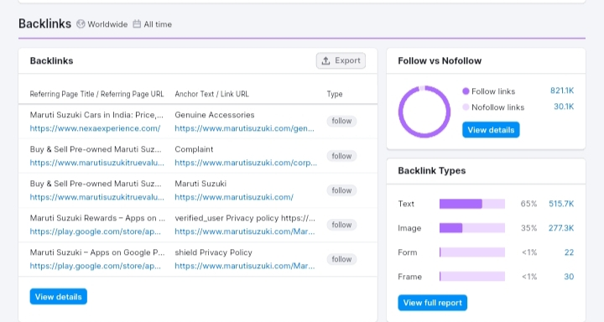
Social media traffic:
marutisuzuki.com gets most of its
social media traffic from Youtube,
followed by WhatsApp Webapp
and Facebook.
Backlinks:
In this stage,we analyse
the quality and quality of the
Website that link back to maruti
suzuki ‘s site.

Slide 17
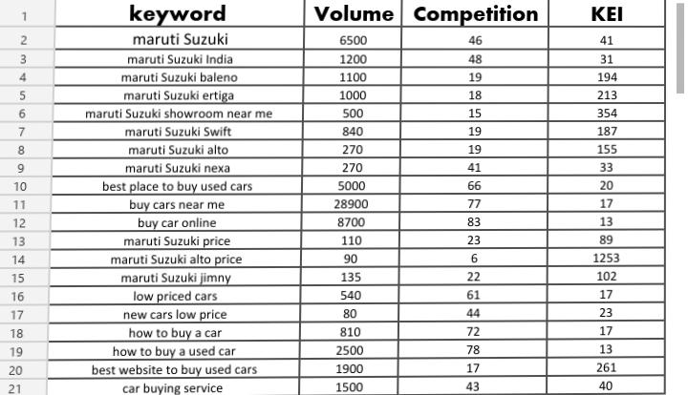
Keyword Research:
We conduct research to identify relevant keywords which are searched by users for obtaining data related to maruti Suzuki .This research helps in optimising website content and meta tags to improve search engine rankings.

Slide 18
On page optimization:
In this ,we focus on optimizing web pages of maruti suzuki website .
We identified how many users are searching relevant keywords and it’s volume, difficulty in searching .
We also identified it’s traffic percentage.
Most of them uses keyword ‘maruthi suzuki car price’ .
Meta tags:
Maruti price,maruti suzuki,suzuki cars,neza,arena,Baleno.
Meta description:
Buy cars from maruti suzuki.
Maruti Suzuki jimny at 12.7 laks.
Launching new suzuki cars.

Slide 19
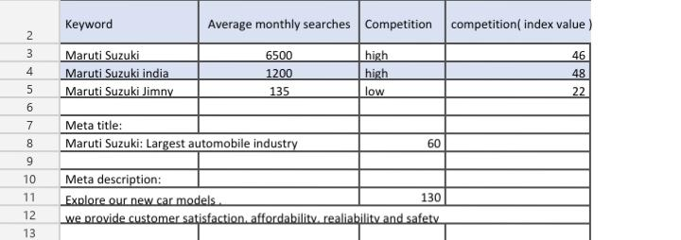

Slide 20
Part -3 Content ideas and Marketing Strategies

Slide 21
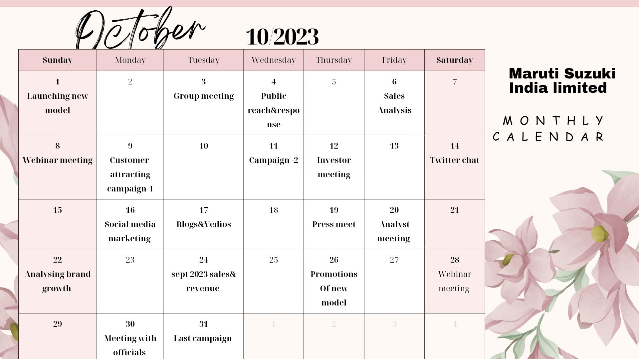
Content calendar of Maruti Suzuki

Slide 22
Marketing Strategies of Maruti Suzuki:
Maruti Suzuki was among the first in the industry to study consumer behaviour and effectively respond to it.It follows various marketing Strategies to increase their sales& revenue.They marketing through following ways:
Marketing Campaigns:
1.Kitna Deti Hai(How much does it give)?
The campaign sums up the Indian obsession with the value for money received from a product/service which in the case of auto refers to the mileage of a car. This was the advertisement video on their youtube channel with the success of 24k+ views.
2.”Kam se Kaam Banega” campaign
The campaign has been very successful in raising awareness about Maruti Suzuki’s fuel-efficient cars and their many benefits. It has also helped the company solidify its position as a market leader in the Indian automobile market.

Slide 23
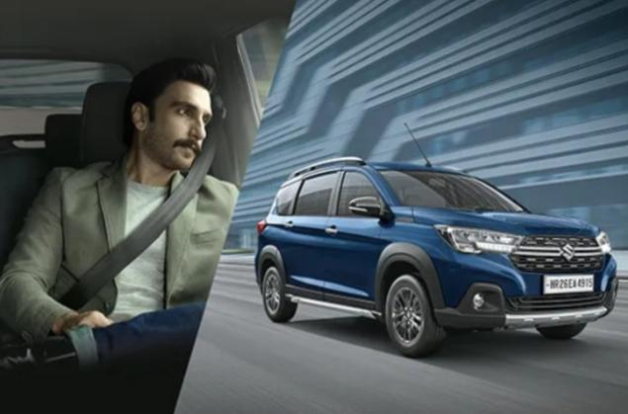
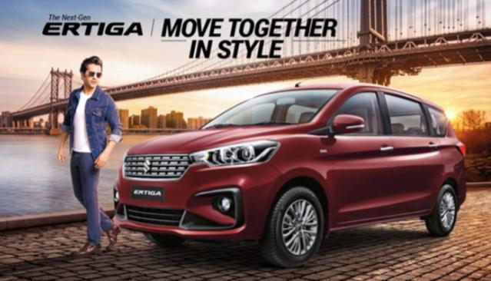
Influencer marketing Strategies
To connect with younger audiences, Maruti Suzuki has partnered with Ten Sports for the cricket rating property ‘Maruti Suzuki Cricket Ratings’. The company has also roped in renowned Bollywood actor Ranveer Singh as its Nexa brand ambassador and Varun Dhawan as a part of the Arena project.

Slide 24
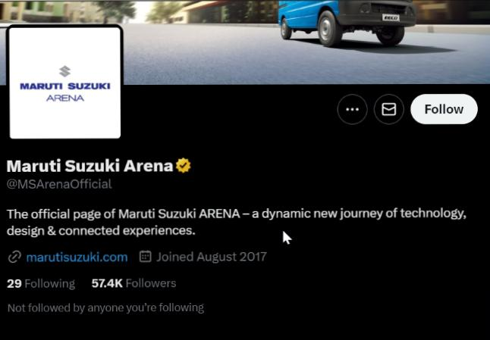
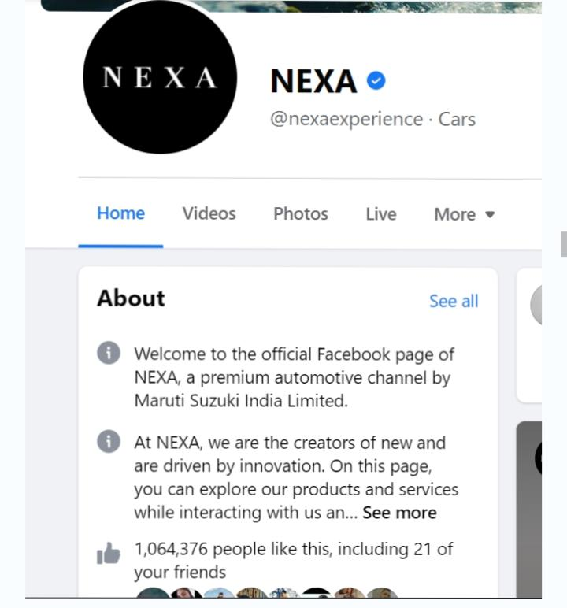
2.Nexa: Maruti’s social media strategy is focused on its Nexa brand, which solely focuses on the premium segment of the brand. Nexa uses social media to connect with luxury car buyers and create an exclusive online buying experience.
Social Media Marketing Strategy:
1.Arena:
Maruti’s social media strategy is focused on its Maruti Suzuki Arena brand, which focuses on the showroom experience through technology, design, and Connected Experience.

Slide 25
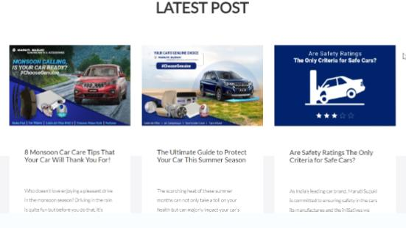
Content Marketing Strategy
The company has published multiple blogs and posts on its website and platforms like Twitter, highlighting the benefits of owning a Maruti Suzuki car.
This content has helped educate users and show them the value that they would receive as customers of the company.

Slide 26
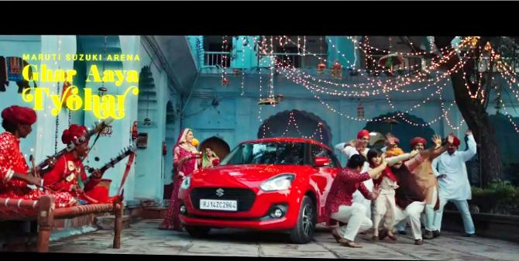
Maruti Suzuki Promotional Strategy
They have invested heavily in television and print advertising over the years and this has helped them in targeting a wider audience.
The company constantly strives to provide its customers with the best possible experience through its advertisements that often connects to the heart of its customers.
Maruti Suzuki also advertises in popular print media such as newspapers and magazines. They have used this medium to target specific segments such as women customers with their ‘Rivals Wanted’ campaign. Billboards, hoardings, and bus shelters are published extensively by the company to catch customers’ attention on the move.
Some of their popular Television commercials are ‘Ghar aya Tyohar’, ‘Baleno: Made of mettle’, and, ‘S-Presso: Live it up to every adventure’.

Slide 27
Challenges encountered:
FY22 was a challenging year for Maruti Suzuki as the company reported its single biggest slide in market share in a year. The company closed the year with a share of 43.38 percent which was at its worst level since FY14. The Delhi-based company blames shortage of semiconductors for the fall in market share.
Pandemic-related uncertainties and health of our people, global shortage of semiconductors, rising commodity prices, upcoming fuel-efficiency and BSVI Phase-2 regulations, shortage of shipping containers, and import restrictions
Lessons learned:
We learned running a business is very difficult but if we believe in ourselves then we will definitely succeed.
We should develop a teamwork and friendly relationship with employees to obtain a great success and growth in our business.
From this we have learned how to do marketing through digital media.

Slide 28
Part -4 Content creation and Curation

Slide 29
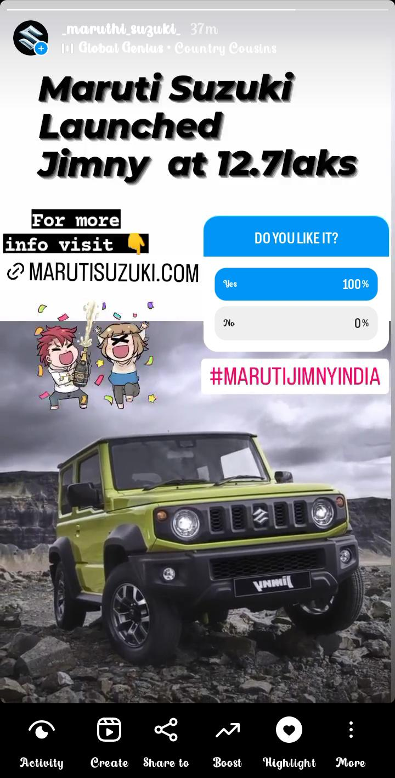
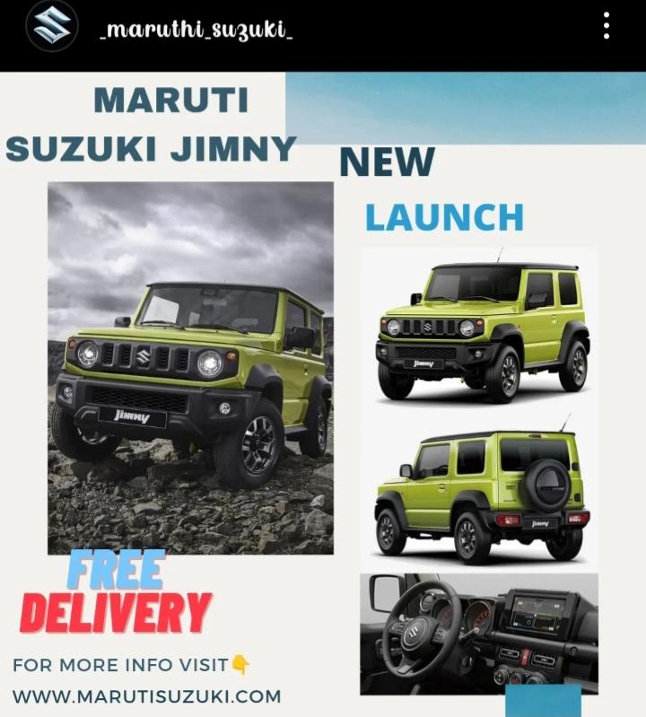
Content Creation:
Format 1:Post/Story
Post link:https://www.instagram.com/p/CyXuuONyg_h/?igshid=MmU2YjMzNjRlOQ==

Slide 30
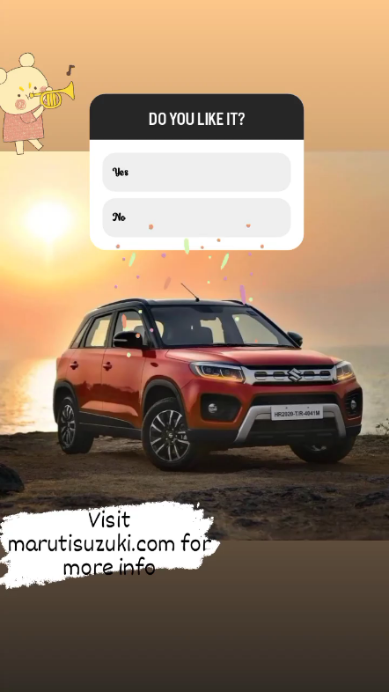
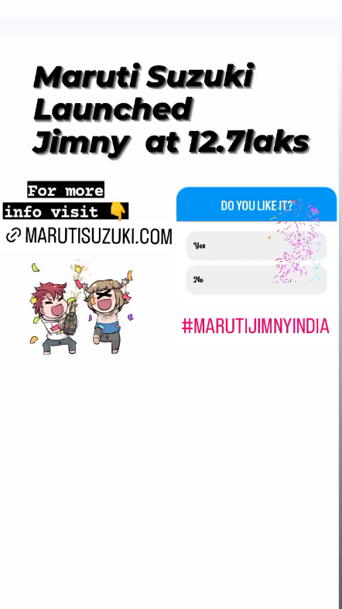

Slide 31
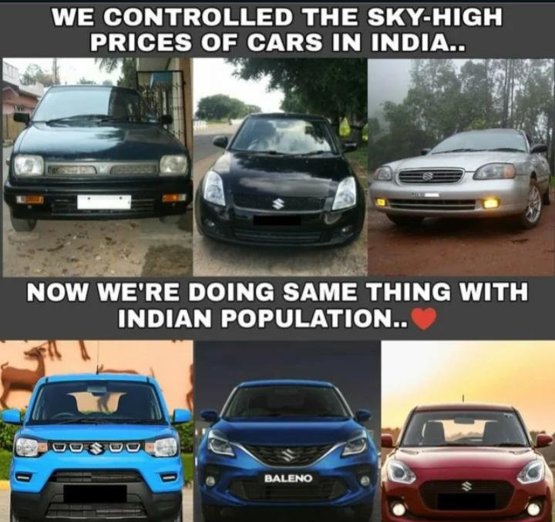
Format 2: Meme
With this meme,we can say that Maruti Suzuki offers cars which are safe, unique and mostly they are low cost.They are fulfilling dreams of everyone who wants to buy cars at low price.

Slide 32
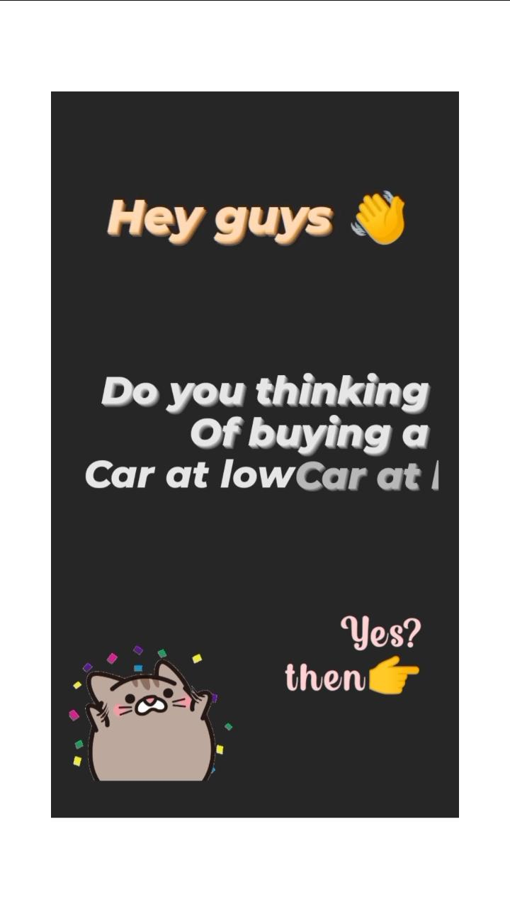
Format 3:Reel/Video
Link:
https://www.canva.com/design/DAFxO2ilekA/Py5qp4Jq8FI3TR9YMMpCEQ/edit?utm_content=DAFxO2ilekA&utm_campaign=designshare&utm_medium=link2&utm_source=sharebutton
#marutiswift
#marutisuzuki
#buycarslowprice

Slide 33
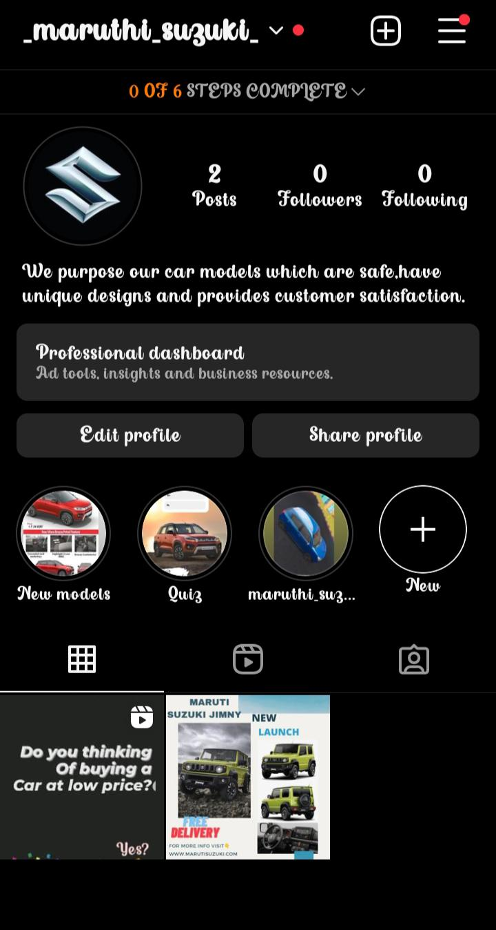
Instagram profile link:
https://instagram.com/_maruthi_suzuki_?igshid=NzZlODBkYWE4Ng==
Instagram Story link:
https://instagram.com/stories/_maruthi_suzuki_/3212448673074750704?utm_source=ig_story_item_share&igshid=NjZiM2M3MzIxNA==

Slide 34
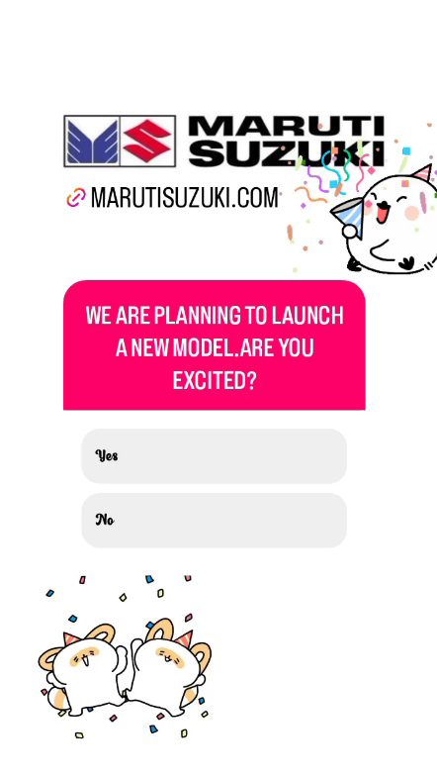
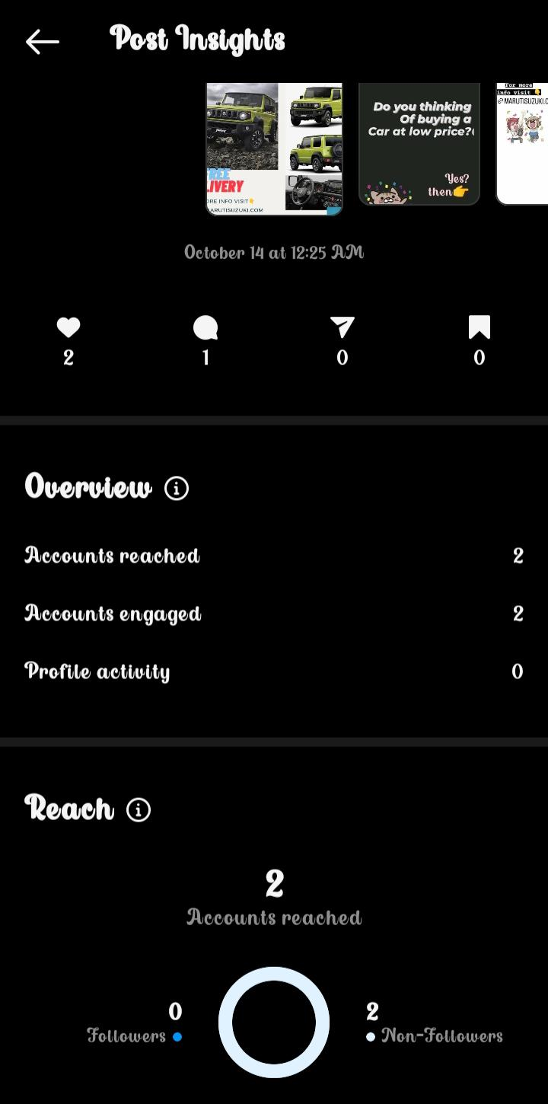
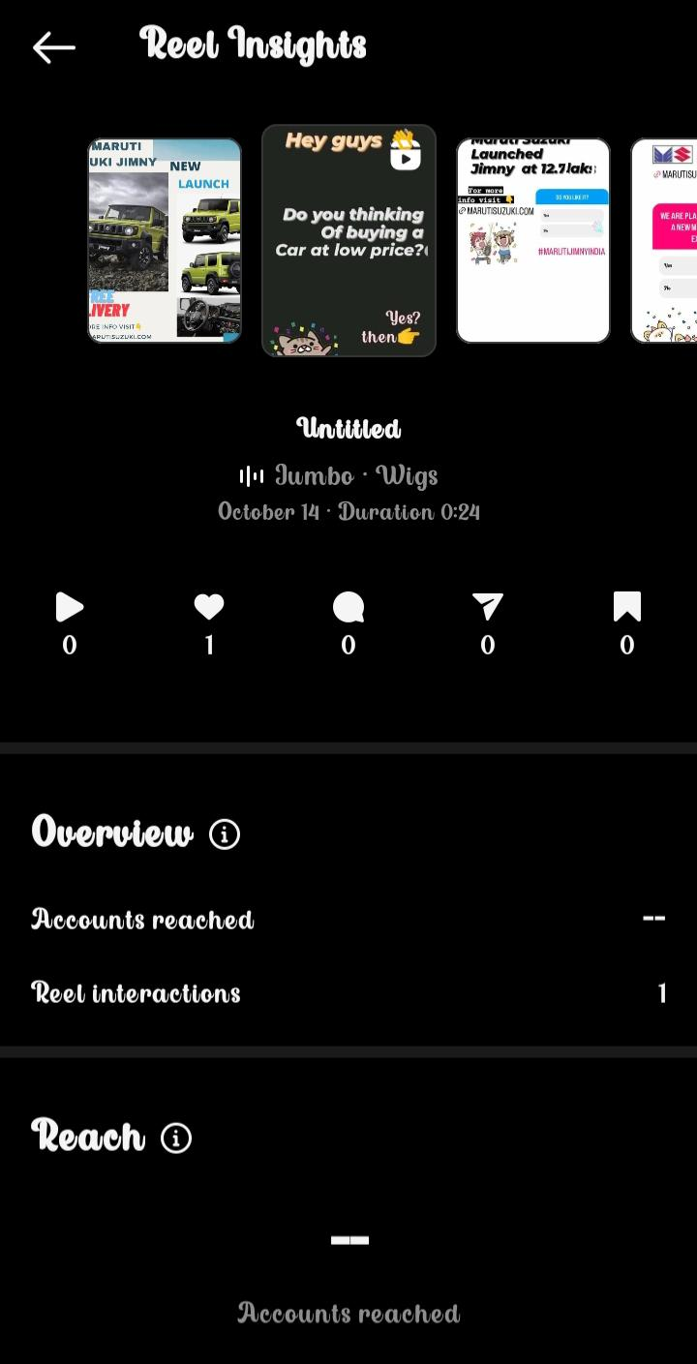
Insights

Slide 35
Project done by: Team leader: Maddili Swapna Team members: 1.Naviri Suguna 2.Nayana Harika 3.Revalla Sharmila 4.Sailada Bhagyasri
Thank you

